Slide 1
E-Vetronics Phase 1 Overview
Shane Sopel
DISTRIBUTION STATEMENT A.
DISTRIBUTION STATEMENT A. Approved for public release; distribution is unlimited. OPSEC#10931​

Slide 2
AGENDA
What is E-Vetronics?
Key Components to our Architecture:
  Time Sensitive Networking (TSN)
  IO Adapter
  Slip Ring
  Sensor Distribution Fabric
E-Vetronics Achievements & Next Steps
DISTRIBUTION STATEMENT A. Approved for public release; distribution is unlimited OPSEC #10931

Slide 3
WHAT IS E-VETRONICS?
Objective:
•Develop & demonstrate a common military standard open architecture for ground combat vehicles to manage data, video, and power systems to enable future combat vehicle capabilities building upon PEO-GCS’s Common Infrastructure Architecture (GCIA); and informing future GCIA iterations.
Deliverable:
•A TRL 6 comprehensive open ground vehicle architecture, embracing the Modular Open Systems Approach (MOSA), through updates to the GCIA standard.
Why:
•An open architecture standard will lower integration cost, reduce schedule time and non-recurring engineering required to enable or accommodate vehicle enhancements, and provide transition partners a greater ability to control and manage upgrades on their platforms.
•Critical to rapidly incorporating cutting-edge technologies on ground platforms to win on the battlefields of the future.
DISTRIBUTION STATEMENT A. Approved for public release; distribution is unlimited OPSEC # 10931

Slide 4
GCIA
GCIA was a cornerstone initiative for E-Vetronics
Objective was to create an open standard to support agile development and reduce integration timelines
Implementation is planned across many GCS platforms
GCIA serves as a unified backbone for vehicle electronics that enables:
  Enhanced data distribution
  Standardized interface protocols
  Common data services
The GCIA framework represents a significant shift away from proprietary, platform-specific solutions that impede innovation and increase long-term costs.
DISTRIBUTION STATEMENT A. Approved for public release; distribution is unlimited OPSEC # 10931

Slide 5
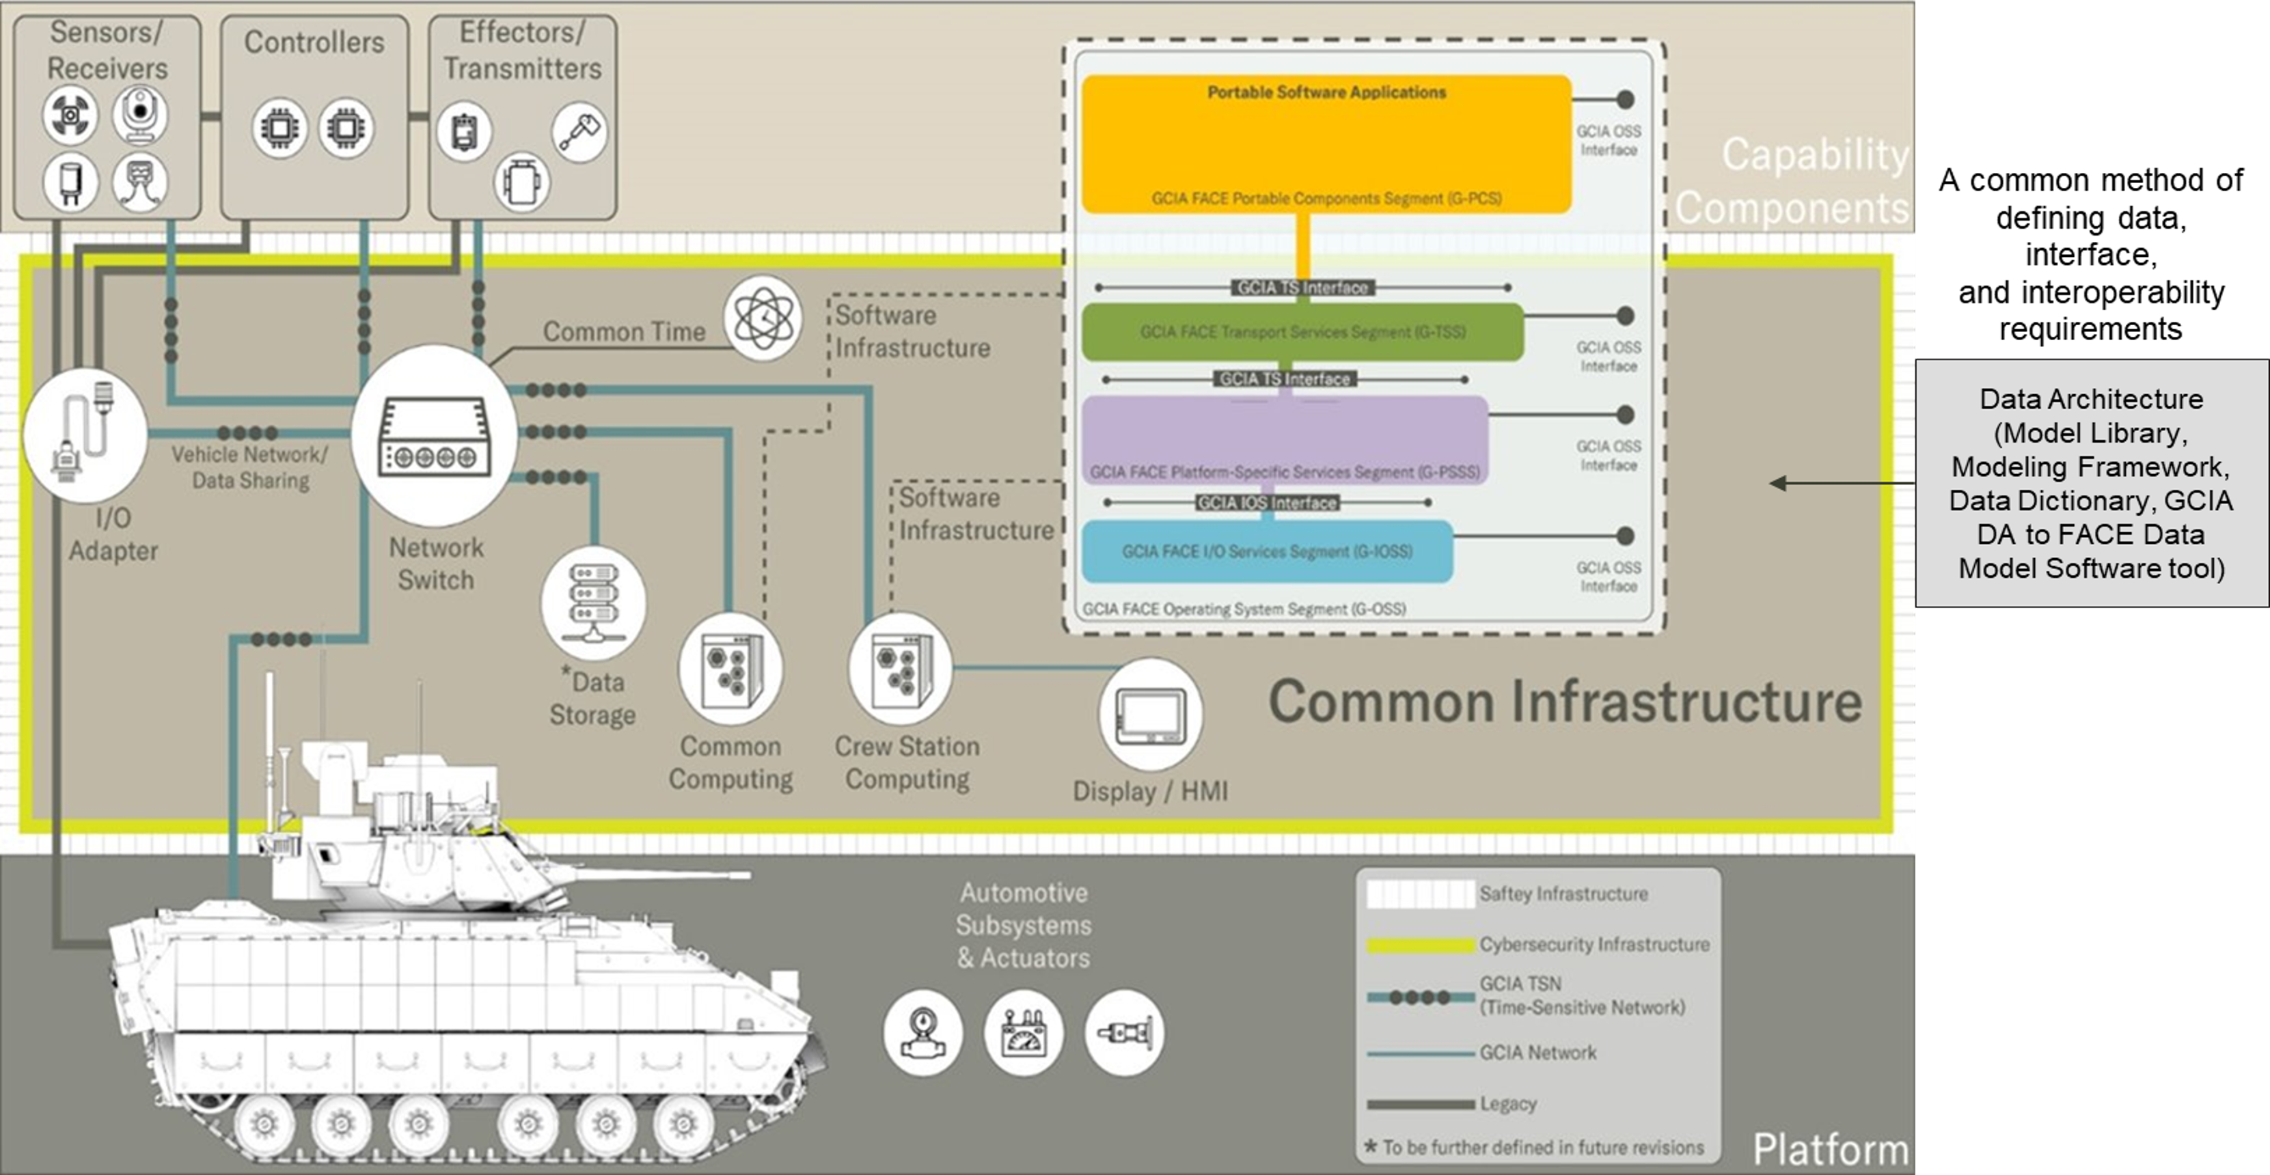
GCIA Infrastructure components used in E-vetronics
DISTRIBUTION STATEMENT A. Approved for public release; distribution is unlimited OPSEC # 10931

Slide 6
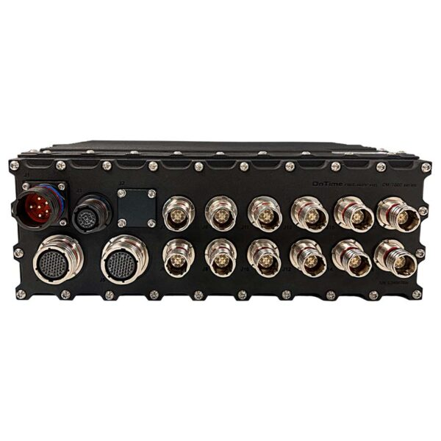
Time Sensitive Networking (TSN)
Deterministic Infrastructure: An Ethernet-based network architecture engineered to provide hard, real-time guarantees for critical data delivery.
Determinism vs. Speed: TSN is not defined by raw throughput or speed; rather, it focuses on delivering bounded, predictable latency and near-zero jitter—the exact requirements for safety-critical systems and tight control loops.
Validation & Verification: To successfully deploy TSN endpoints, we must rigorously define the architectural requirements and establish testing methodologies to definitively prove deterministic data delivery.
DISTRIBUTION STATEMENT A. Approved for public release; distribution is unlimited OPSEC # 10931

Slide 7
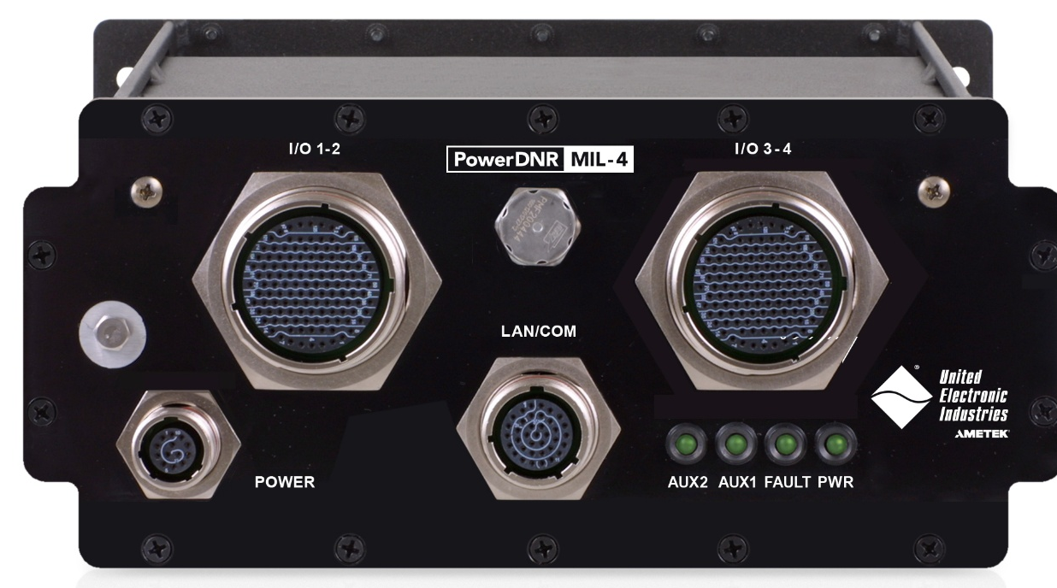
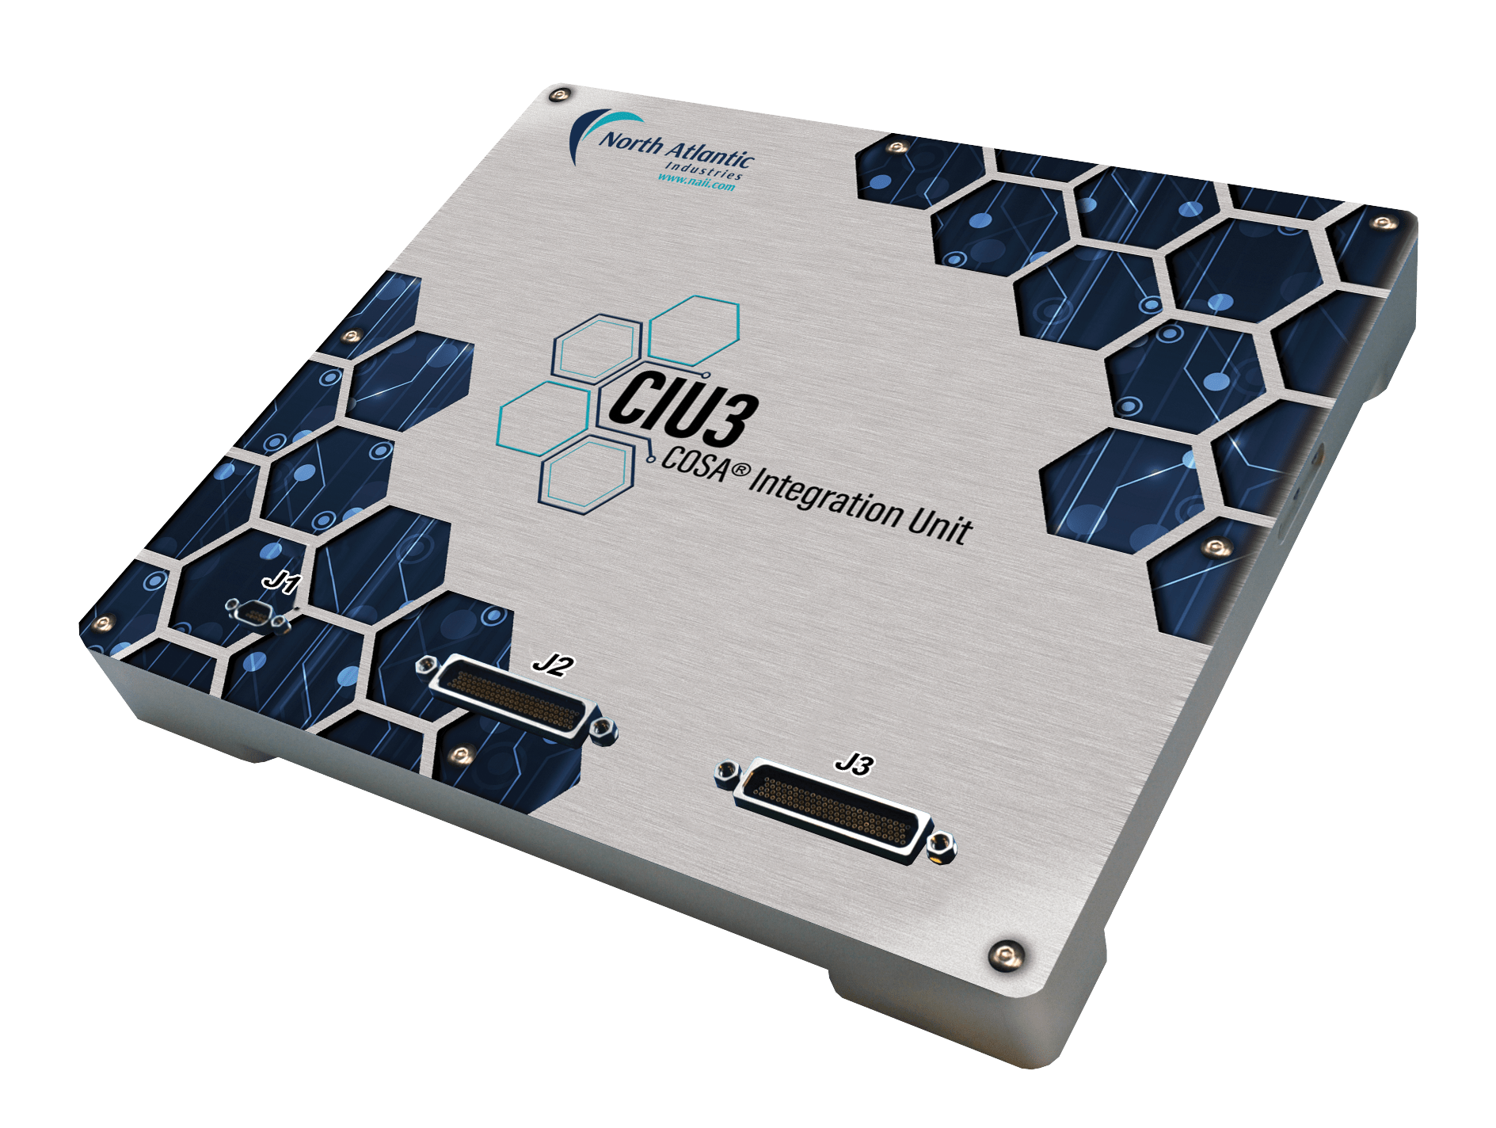
I/O Adapters
MOSA-Aligned Data Distribution: Leveraging a Modular Open Systems Approach (MOSA) to develop universal I/O adapters that ingest diverse data streams and seamlessly distribute them to distributed processing nodes across the vehicle.’
Deterministic Flexibility: Broadening interface flexibility while guaranteeing hard, real-time data delivery by integrating Time-Sensitive Networking (TSN) for bounded latency and low jitter.
Legacy Integration & Modernization: Providing a bridge for legacy platforms, allowing older capabilities and legacy subsystems to integrate seamlessly into a modern, open architecture.
Data Availability: Establishing a vehicle-wide data fabric that eliminates information silos, ensuring data can be routed anywhere on the platform in real time.
DISTRIBUTION STATEMENT A. Approved for public release; distribution is unlimited OPSEC # 10931

Slide 8
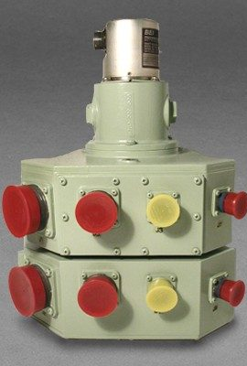
Slip Ring
The Legacy Infrastructure Challenge: While advanced Modular Open Systems Approach (MOSA) technologies offer unprecedented capability, legacy turret slip rings act as a severe hardware bottleneck, lacking interfaces to support the required data across the vehicle.
Future-Proofing Vehicle Architecture: To unlock the full potential of MOSA, we are developed (and continue to develop) a next-generation slip ring engineered to support modern data protocols today, while establishing a scalable foundation for seamless future upgrades.
DISTRIBUTION STATEMENT A. Approved for public release; distribution is unlimited OPSEC #10931

Slide 9
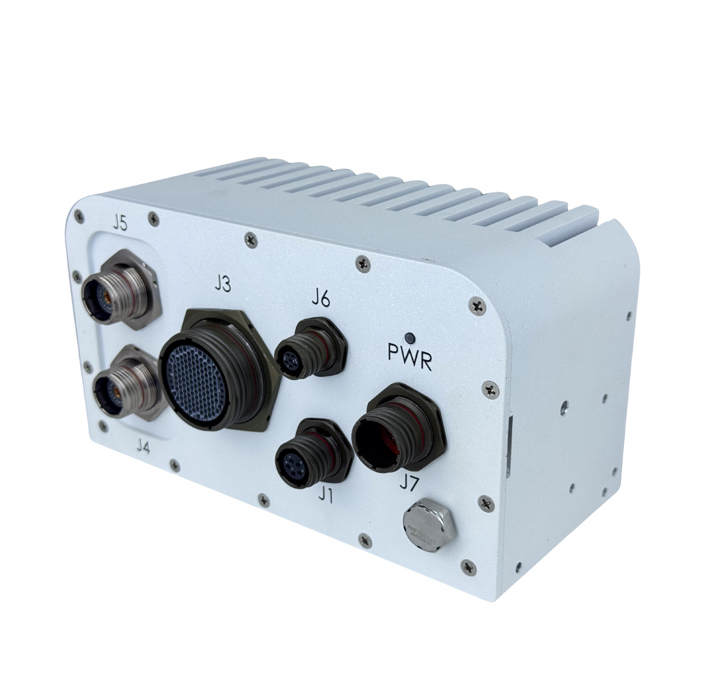
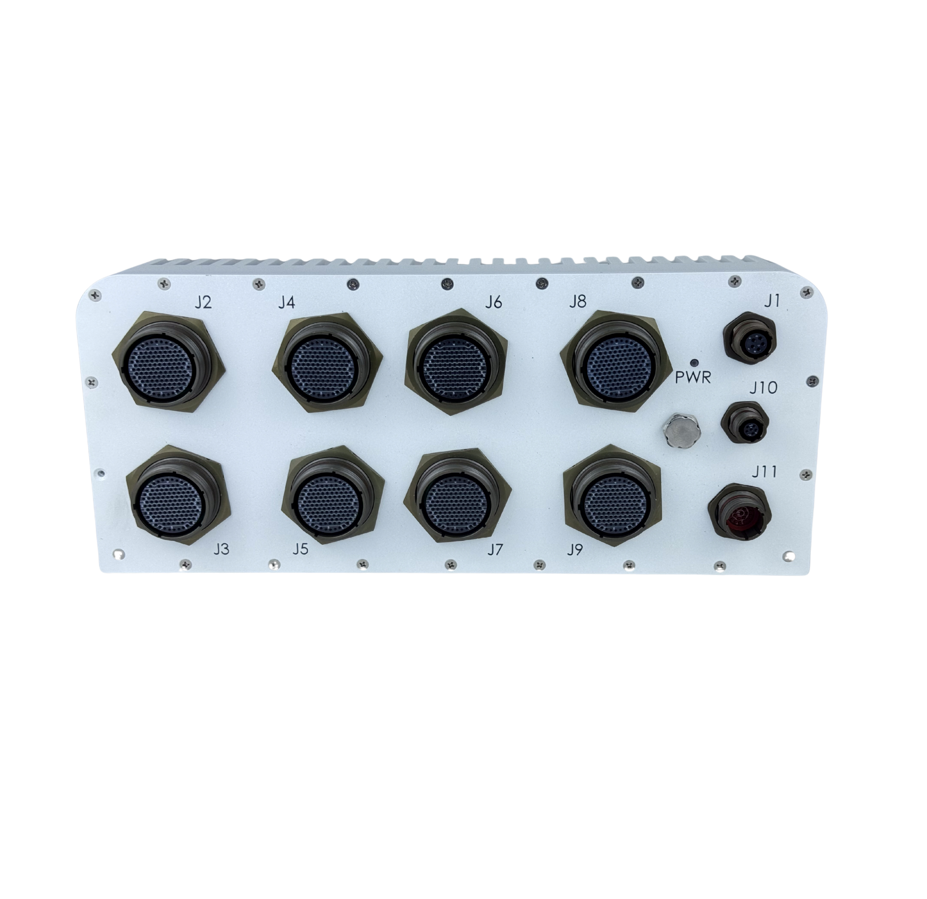
Sensor Distribution Fabric
The Structural Challenge: Baseline experimentation confirmed that sensor data streams with standard command-and-control traffic on a single Ethernet bus inevitably drives network congestion and risks latency spikes.
The Architecture Breakthrough: By offloading data-heavy pipelines to a dedicated fabric, we successfully isolated and eliminated the primary network bottleneck.
The Strategic Result: This dual-fabric approach delivers ultra-low latency for heavy data processing while ensuring the primary network remains completely unhindered, enabling flawless, deterministic command-and-control functionality.
DISTRIBUTION STATEMENT A. Approved for public release; distribution is unlimited OPSEC # 10931

Slide 10
E-Vetronics Achievements & Next Steps
Core Achievements & Current Initiatives
Collaborative Open Architecture: Partnering with industry leaders to design and deliver modular, open-architecture components that eliminate vendor lock-in and accelerate technology insertion.
Data Availability: Designing a seamless, unified network fabric that ensures critical data is securely accessible anywhere, anytime, across the entire platform.
Hull-to-Turret Interoperability: Engineering robust, standardized interfaces to seamlessly bridge data between the vehicle's hull and turret systems.
Sensor Distribution Bus: Architecting the fabric designed to handle data distribution in the harshest physical environments.
The Next Phase: Reshaping Modern Vehicle Architecture
Enabling Real-Time Edge Computing: Bringing AI-driven decision-making to the tactical edge with unprecedented speed.
Scalability: Allowing rapid, plug-and-play upgrades of software and hardware without requiring a complete system overhaul.
Survivability: Ensuring the network remains resilient and data continues to flow even under severe combat degradation.
DISTRIBUTION STATEMENT A. Approved for public release; distribution is unlimited OPSEC#10931

